Slide 1

Securing a Small Network using Cisco Packet Tracer.
Zeyad Moustafa (Team leader )
Basmala Atef

Slide 2
Introduction:
Our project aims to design and secure a computer network using Cisco Packet Tracer.
We implemented several networking and security technologies.
The main goal is to ensure efficiency, reliability, and security of the network.

Slide 3
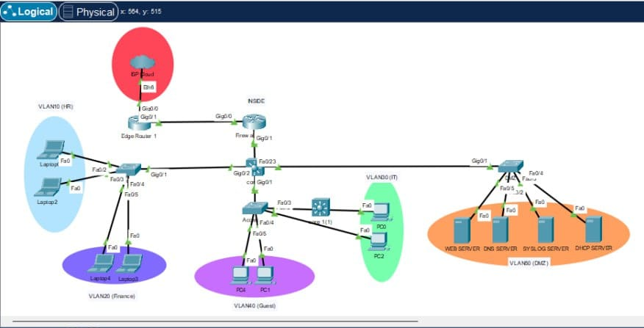
Network Topology:
This is our network topology.
It contains multiple routers, switches, servers, and end devices.
The topology provides connectivity and security for users.

Slide 4
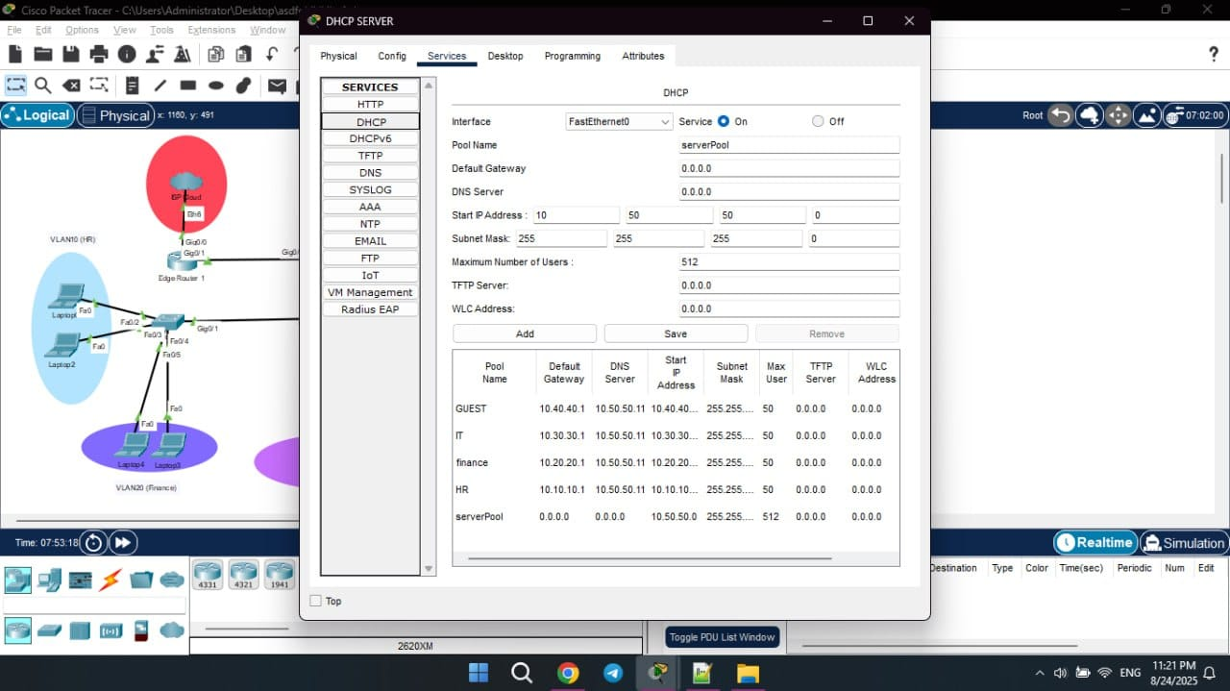
Configurations & Technologies
DHCP Server:
"DHCP Server automatically assigns IP addresses to devices."

Slide 5
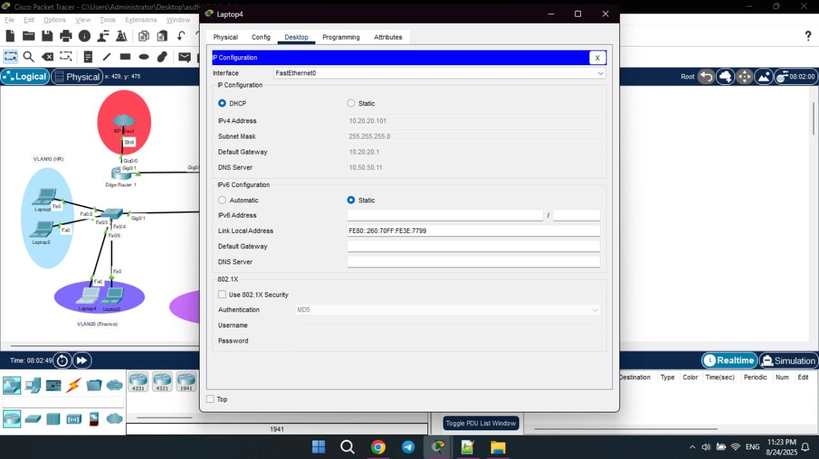
Configurations & Technologies
IP Assignment:
"End devices received dynamic IP addresses via DHCP."

Slide 6
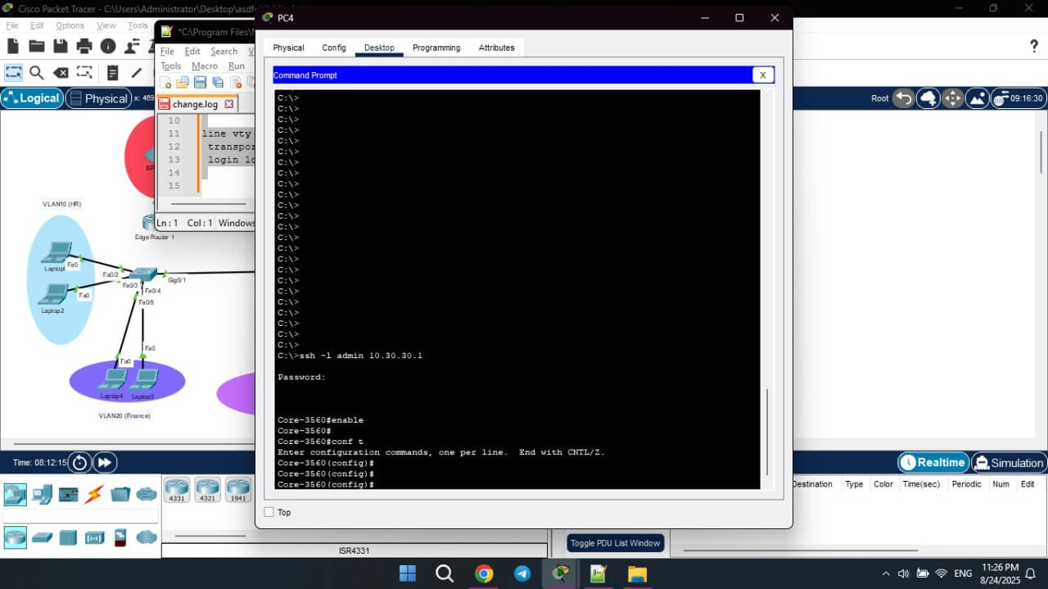
Configurations & Technologies
SSH Access:
"SSH allows secure remote login from the laptop to network devices."

Slide 7
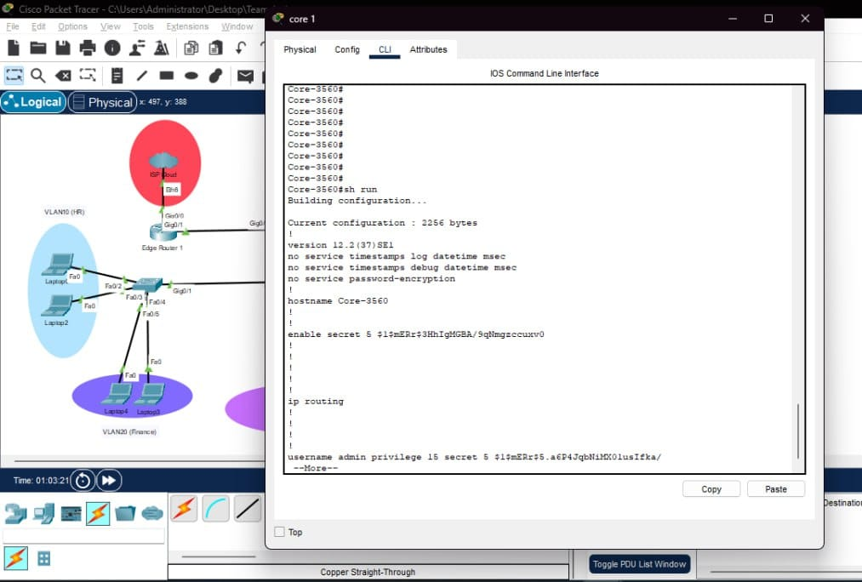
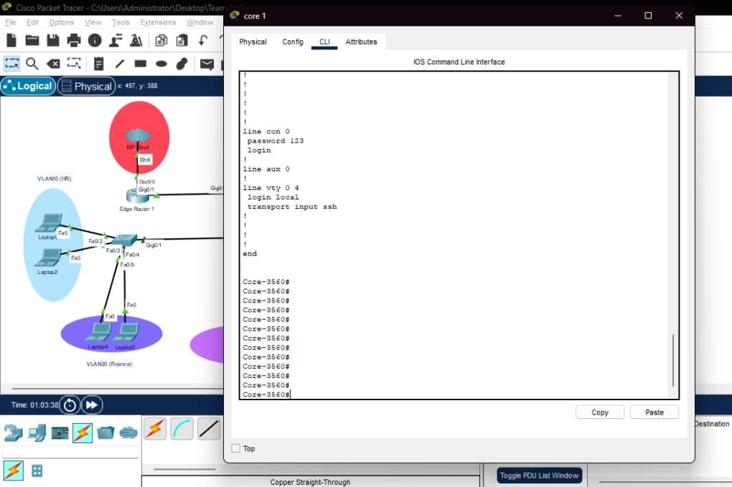
Device Access Security:
Secret Password:
SSH + Console Password Config:
"Password configured as secret → stored encrypted."
"SSH and console password configured for secure access."

Slide 8
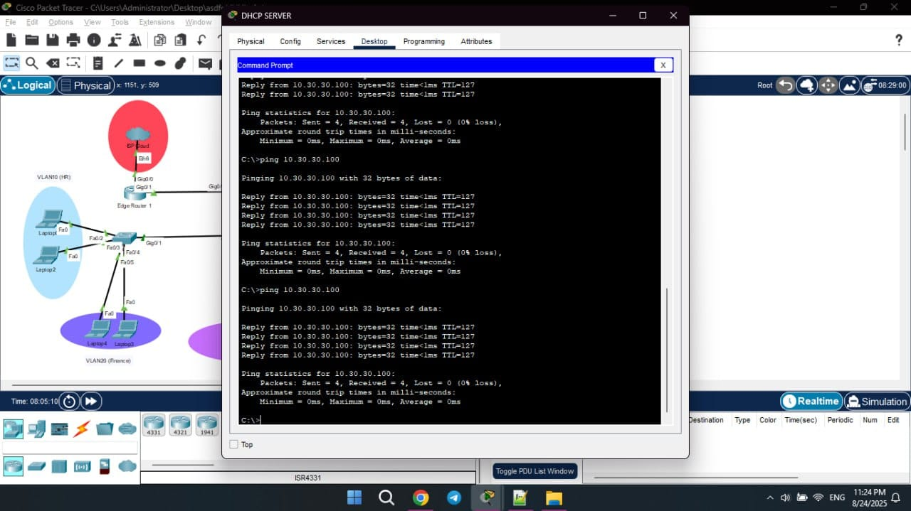
Configurations & Technologies
Ping Test:
"Ping test ensures connectivity between devices."

Slide 9
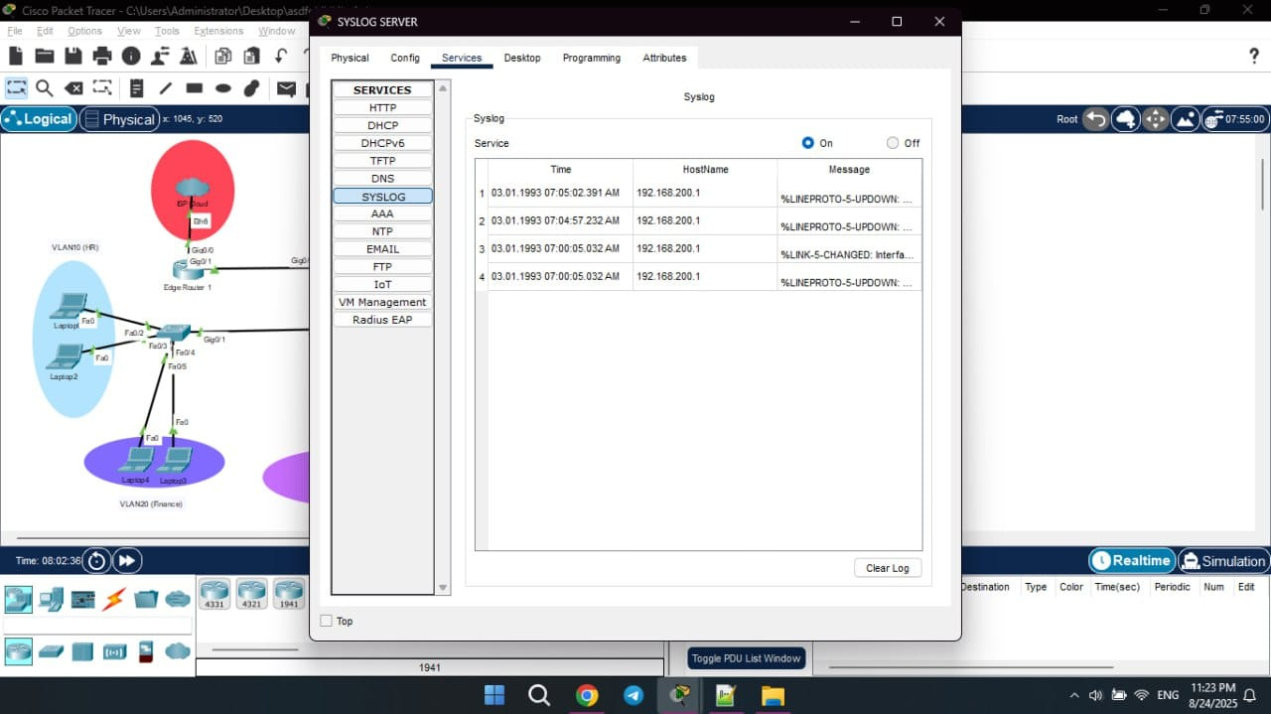
Configurations & Technologies
Syslog Messages:
"Syslog server collects and displays network log messages."

Slide 10
“Implemented Technologies”
ACLs (Access Control Lists):
Define rules to allow or block specific traffic based on IP, port, or protocol. They help in controlling access and improving network security.
NAT (Network Address Translation):
Converts private IP addresses into public IPs so devices can access the internet. It also helps in conserving IPv4 addresses.
DHCP Snooping:
Monitors DHCP messages and blocks fake DHCP servers from giving IPs. Protects the network from man-in-the-middle attacks.

Slide 11
“Implemented Technologies”
ARP Inspection (Dynamic ARP Inspection):
Verifies ARP packets to ensure they are legitimate. Prevents attackers from sending false ARP replies.
Firewall:
Acts as a barrier between the network and external threats. It filters harmful traffic and allows only trusted communication.
VPN (Virtual Private Network):
Establishes an encrypted tunnel for remote users to connect securely to the network. Protects data while traveling over the internet.

Slide 12
“Implemented Technologies”
IDS (Intrusion Detection System):
Monitors network activity to detect suspicious patterns or attacks. Alerts administrators about possible threats.
IPS (Intrusion Prevention System):
Monitors traffic in real-time and blocks malicious activities instantly.
SSH (Secure Shell):
Provides a secure way to remotely log into and manage devices. All communication is encrypted to prevent eavesdropping.
Syslog:
Collects log messages from devices into a central server. Helps in troubleshooting and monitoring network activities.

Slide 13
Live Demo

Slide 14
Conclusion
The network became secure, stable, and flexible.
We learned how to implement important networking & security tools.

Slide 15
Thank you

